Slide 1
City Harbormaster Report
Presentation to Harbor Commission
May 11, 2022
Paul Blank
Harbormaster

Slide 2
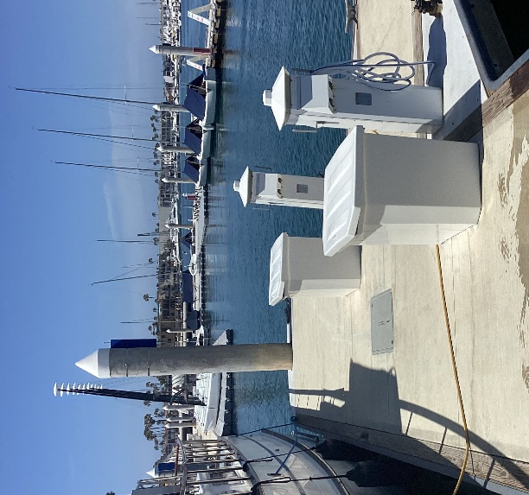
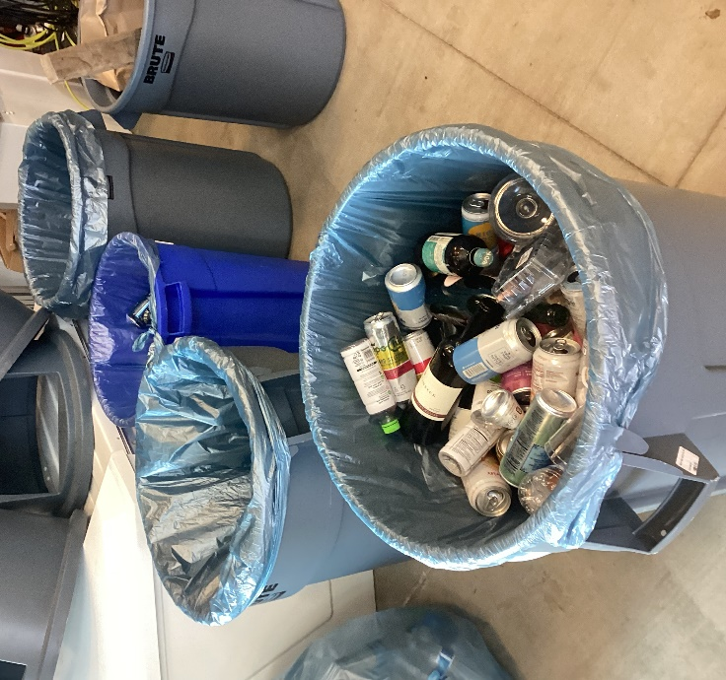
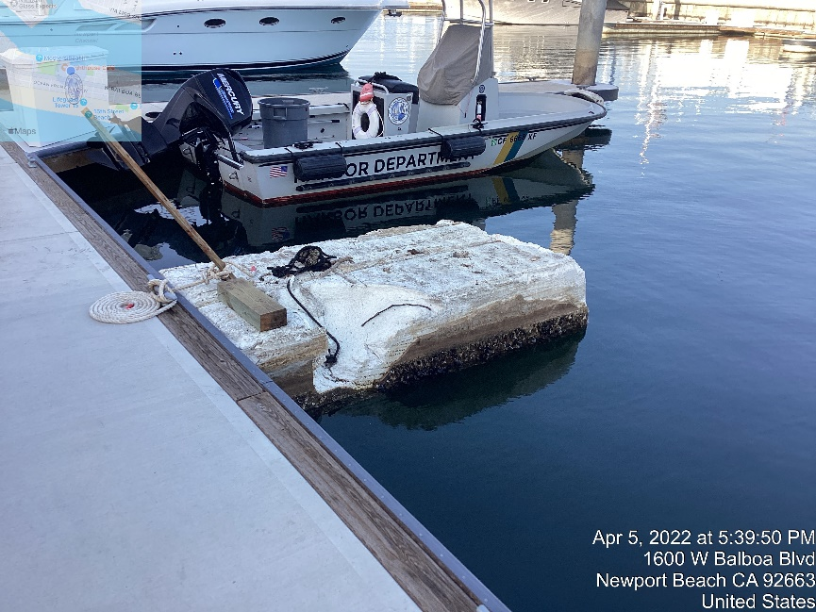
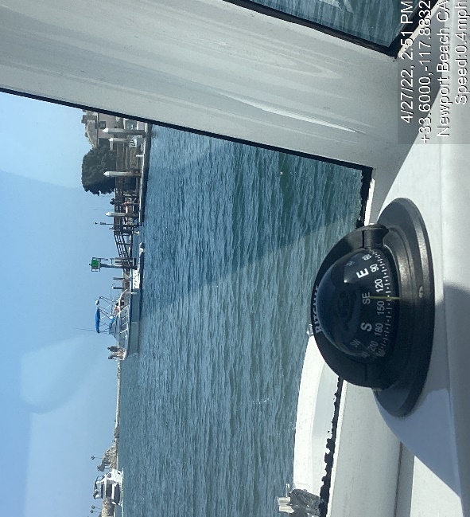
Clean
Spring cleaning and spruce up at Marina Park
Damage to the public pier at Coral was removed and repaired
Vessel which overstayed its welcome and had operational issues was escorted out of the harbor
Harbor Department Activities Report

Slide 3
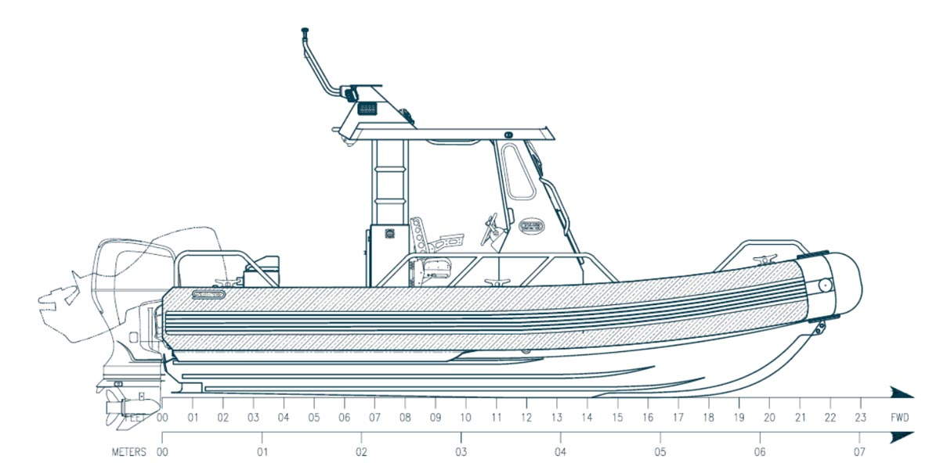
Safe
Grant application for replacement patrol boat submitted
Focus:
Safe and secure mooring assists
Search and rescue with emphasis on manual powered craft
Patrols in severe weather
Harbor Department Activities Report

Slide 4
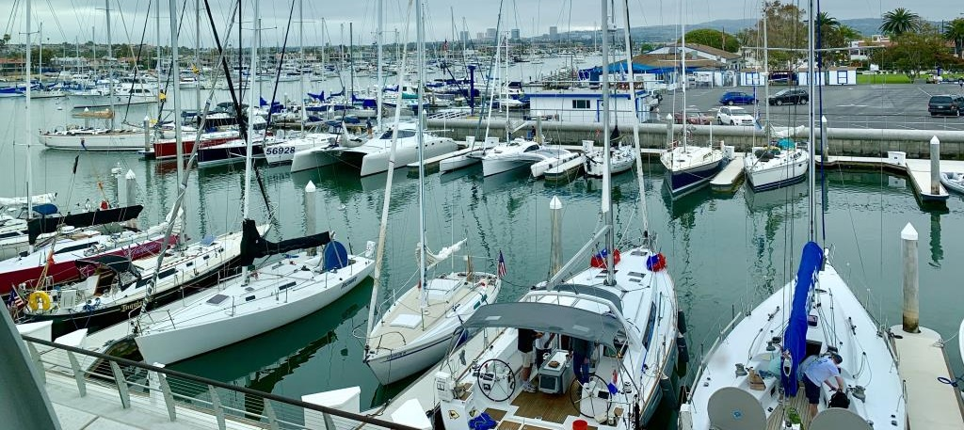
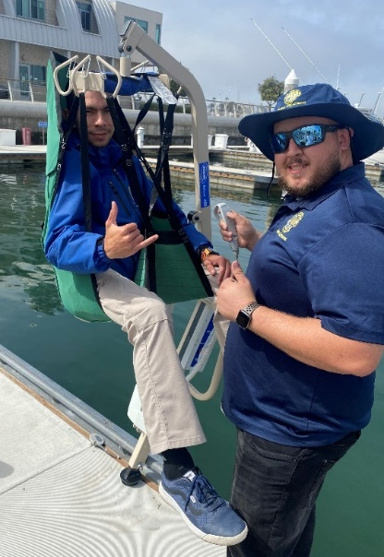
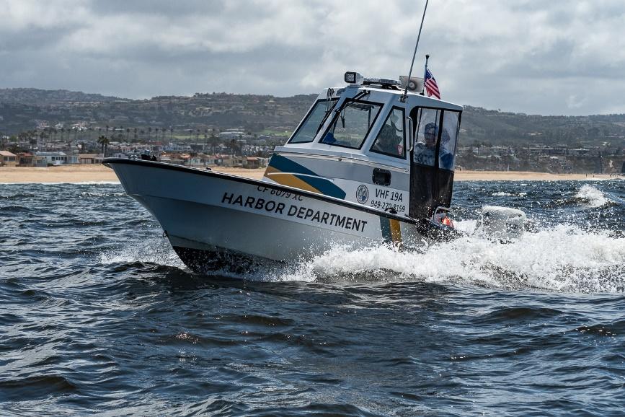
Well-enjoyed
Human Lift demonstration and practice
Support for Newport to Ensenada Race
Harbor Department Activities Report

Slide 5
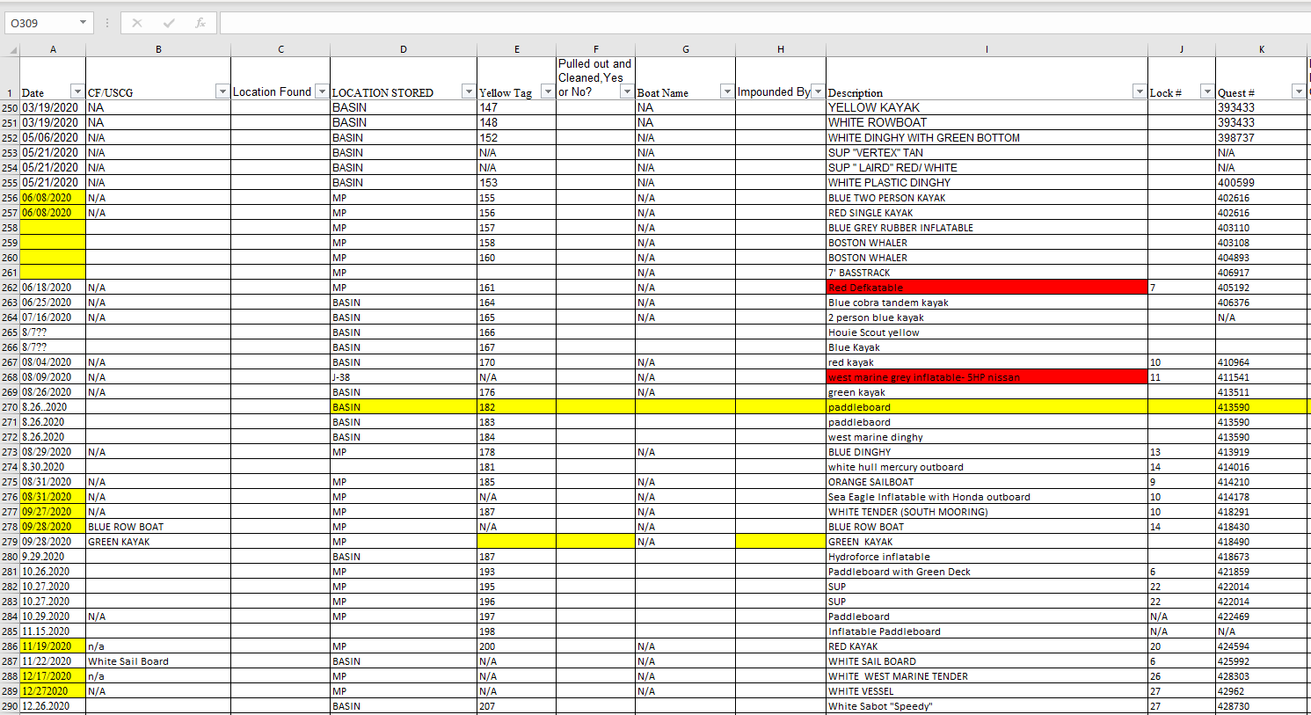
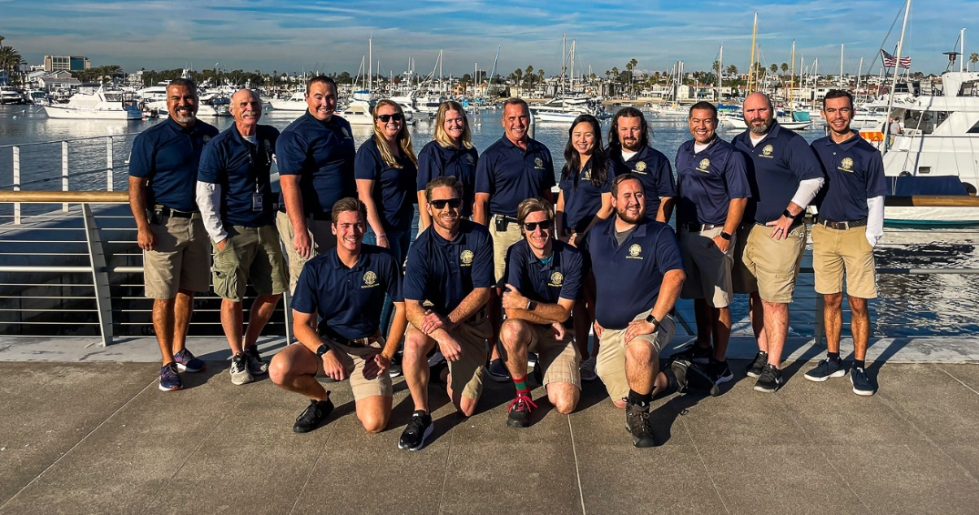
Odds and Ends
Automated Impound Log and Inventory Management tool
What a year it has been:
Team training and development
Patrol vessel improvements
Revenue improvements
Improved profile for the Department
West anchorage
Improvements to data capture and reporting
Emergency responses:
Elly oil spill
Tsunami warning
Downed helicopter
Severe weather
Sewage spill
High profile stolen vessel
Harbor Department Activities Report

Slide 6
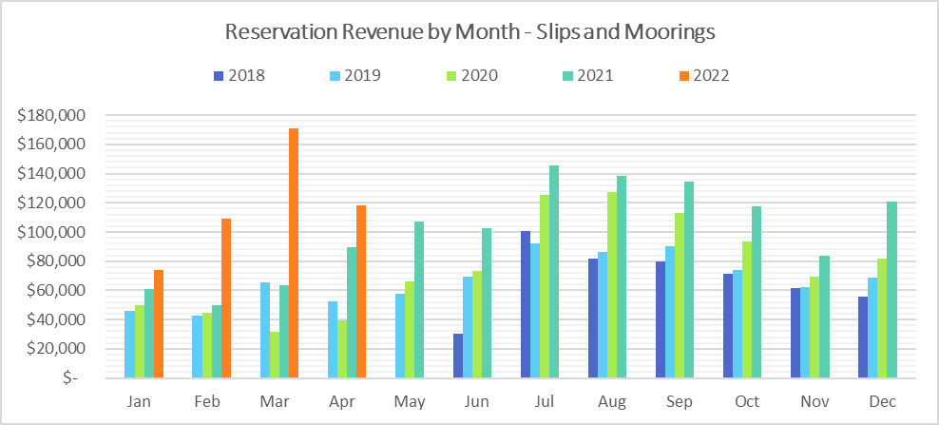
Improved Statistics Reporting
Harbor Department Activities Report

Slide 7
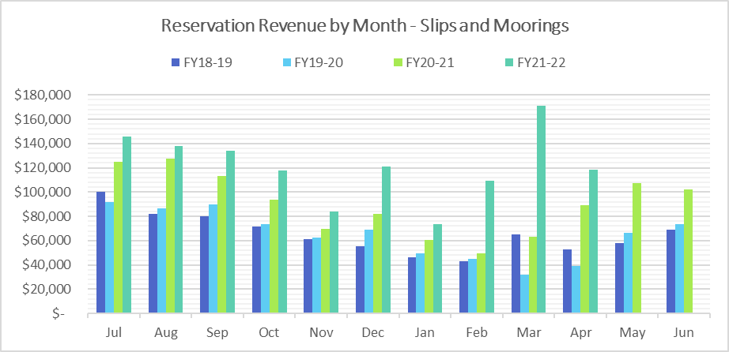
Improved Statistics Reporting
Harbor Department Activities Report

Slide 8
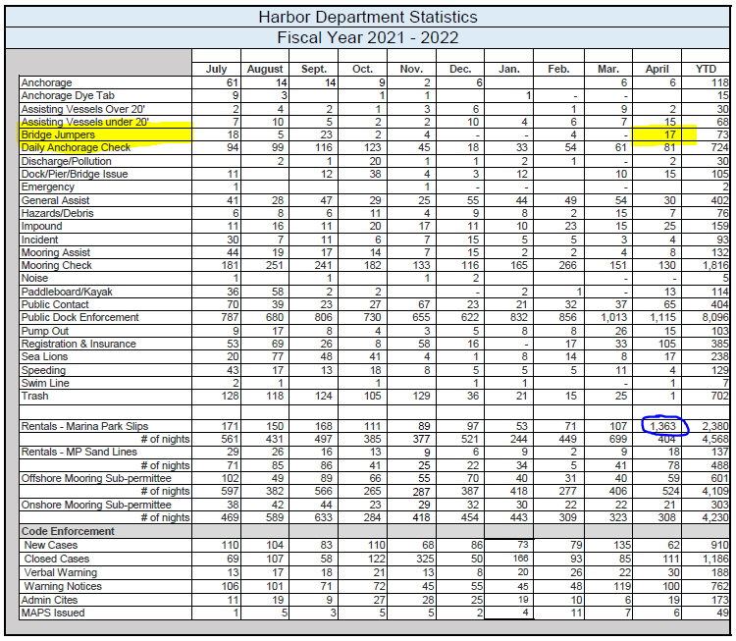
Department Stats - YTD
Harbor Department Activities Report

Slide 9
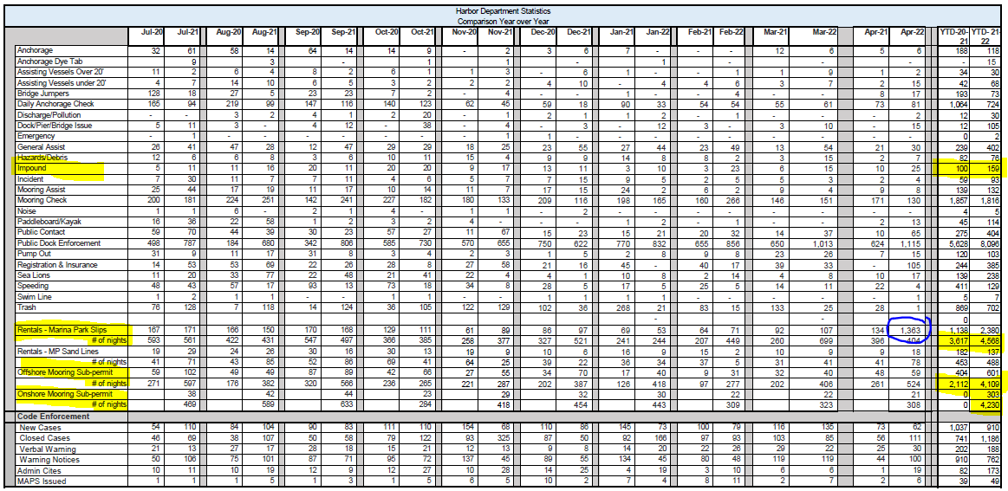
Department Stats - YOY
Harbor Department Activities Report

Slide 10
New Mooring Permit Update – May 2022
Category | Total as of November 2021 | Total as of April 2022 | Total as of May 2022
Total Permits Issued | 929 | 929 | 929
Permits in Process | 195 | 36 | 33
Entered into Harbor Ops | 537 | 769 | 801
Harbor Department Activities Report

Slide 11
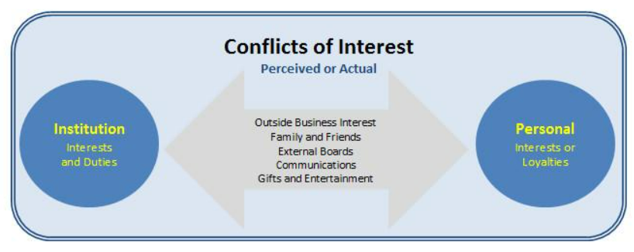
Harbormaster Disclosure
Concern over possible conflict of interest expressed by member of the public
Concerns addressed to the satisfaction of City Attorney before any offer was made
Personnel matter and disclosure is not required
No participation in deliberations or voting
Matters related to real property including moorings are handled by RP Administrator
Any assets of concern are in an irrevocable trust
Any remaining interests are de minimus
Harbor Department Activities Report

Slide 12
City Harbormaster Report
Presentation to Harbor Commission
Paul Blank
Harbormaster

